Slide 1
Beyond Earth
Forest Fire Project

Slide 2
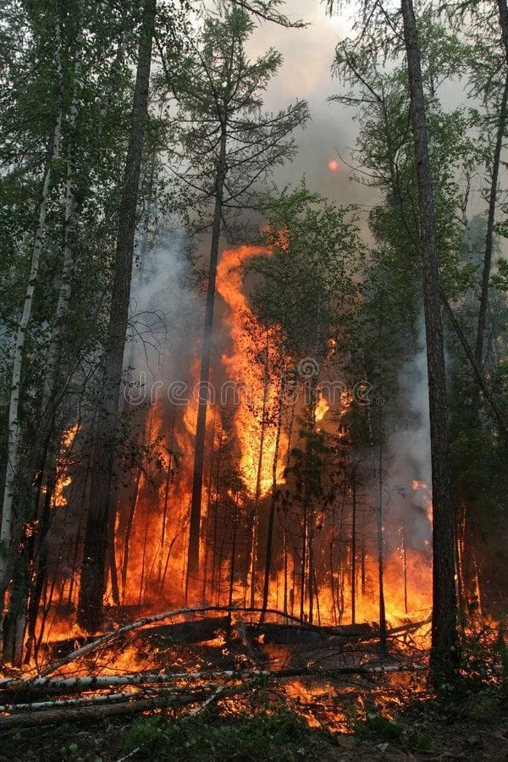

Slide 3
Team Members
Space mission members
Rana Nasser Mohamed ID: S13
AI members
Safwa Ibrahim Salah ID: A58
Omnia Mahmoud Ahmed ID: A128
Habiba Adel Abd-ElGowad ID: A62
Abd-ElRahman Tarek Mahmoud ID: A188
Embeded members
Bansee Abd-ElNasser Mahmoud ID: E146
Youssef Ahmed Mohamed ID: E4
E13 Abd-ElRahman Tamer Mohamed ID:
Team Names

Slide 4


Slide 5


Slide 6
Space Mission ############ Terra Satellite as parameters and Cubesat satellite as a model semi major axis : 7080 km inclination: 120 deg RAAN: 60 deg true anomaly : 30 orbit type: geocentric Eccentricity : 0 orbital : circular the model is cubesat 1u because it has a solar panels number of planes / orbits: 8 number of satellite : 6 per orbit

Slide 7
age of data: less than 30 min ground station 1 : australia -26.439 deg latitude: 133.281 deg longitude : ground station 2 : North of America 47.24 deg latitude: -100.18 deg longitude :

Slide 8
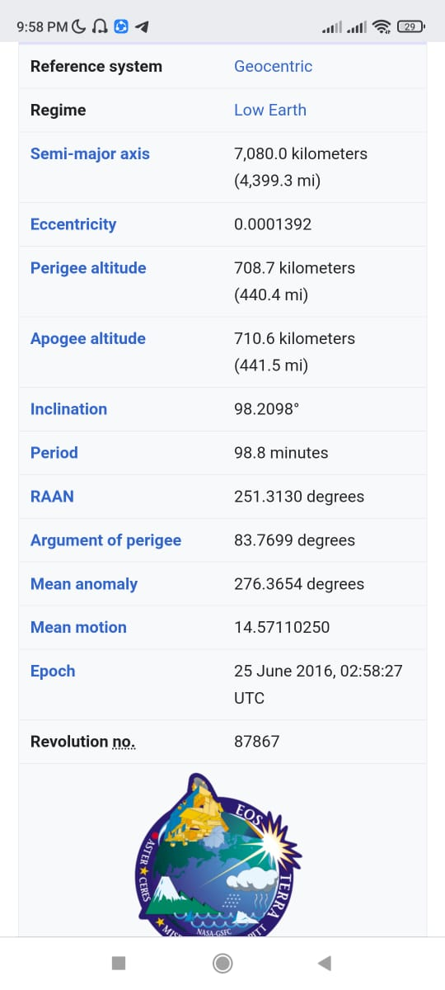

Slide 9
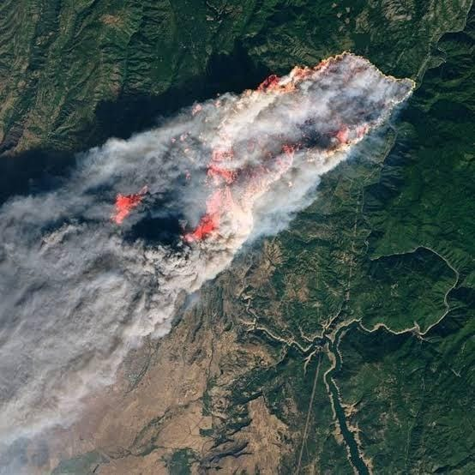

Slide 10
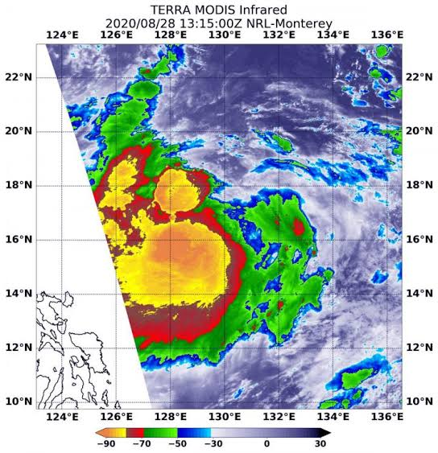

Slide 11
Our project about forest fire the last few years extreme fire occurrences in distant parts of the globe such as Australia, Russia and United States of America (USA) have increased global awareness and concern about the destructive power and profound consequences of forest fires. The complexity and extent of the impacts of forest fires like death of many animals and we will try to solute this problem Death of many animals, especially rare ones, lack of oxygen, ozone layer dilation and damaging the houses and disappearing a lot of planets. by using satellite , we detect wildfire in all world we have dataset that predict the temperature , wind speed , storms , rains , fine fuel moisture and relative humidity and predect them we make 48 satellits orbiting the whole earth and take images forests and if any forest fired the satellites would send these images to the nearest ground staion in earth that connected with them by receiver and transmitters

Slide 12
We use some sensors like Flame sensor detect if there fire or not DHT11 detect the temperature and humidity SD Card Module to store the data NRF24 connection module between receiver and transmitter

Slide 13
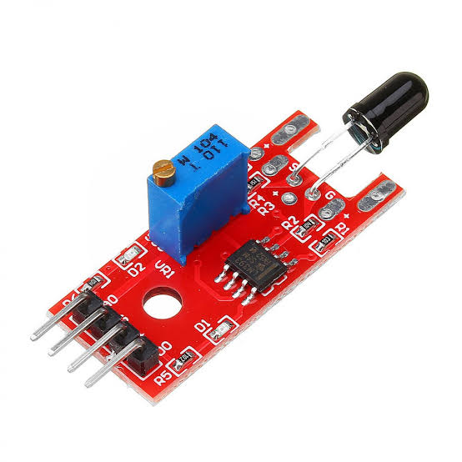
Flame Sensor

Slide 14
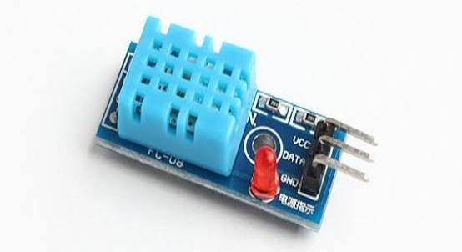
DHT11 Sensor

Slide 15
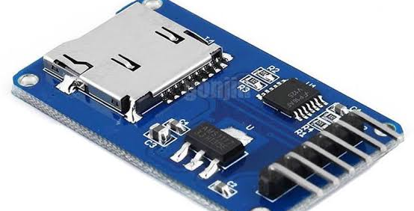
SD Card Module

Slide 16
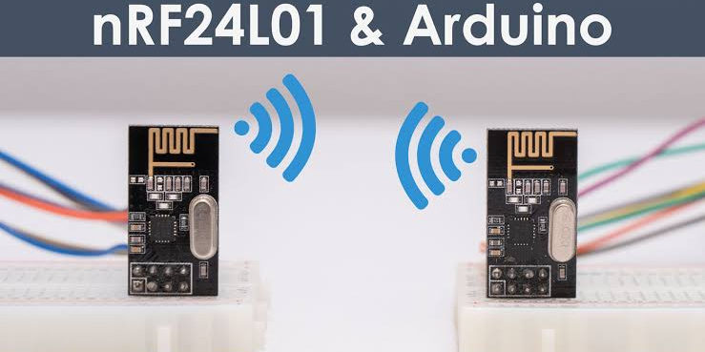
NRF24

